Slide 1
DDR4 Simulation
Ben Huntsman, Jeff nguyen, jon vlas

Slide 2
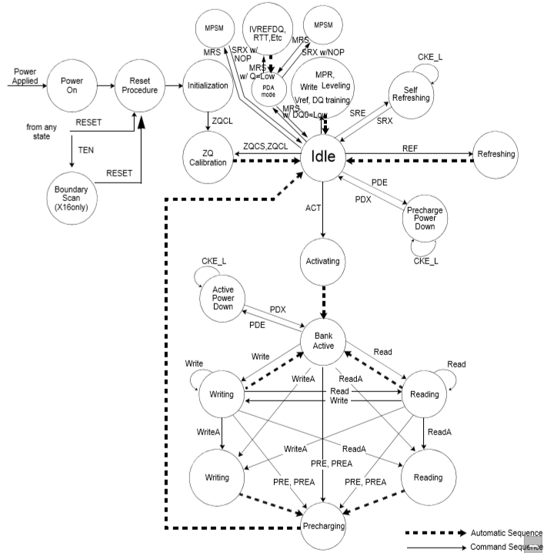
DDR4 FSM
Initialization
Idle
Activating
R/W Loop

Slide 3
Major Components
Control Module
Interface
DIMM

Slide 4
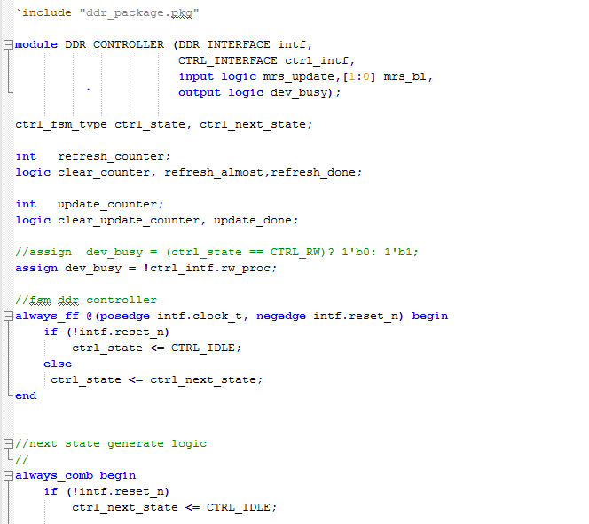
Control Module

Slide 5
Interface

Slide 6
Dimm

Slide 7
Assertions

Slide 8
Testbench

